Slide 1
Module 3 Guidance Notes C++ Basics
COMP2113 Programming Technologies
ENGG1340 Computer Programming II

Slide 2
Before We Start
We will deal with C++ only in this module. and will leave the C counterparts on I/O (i.e., input/output) handling to latter modules.
Important: We will be using the C++ 11 standard, so make sure that your compiler option is set appropriately. We suggest to use the following command to compile your C++ program:
g++ -pedantic-errors -std=c++11 your_program.cpp
The -pedantic-errors flag is to make sure that your code conforms to the ISO C/C++ standard. We will enforce this in your assignment submission too. For more information about C/C++ standards, you may read https://en.wikipedia.org/wiki/ANSI_C and https://isocpp.org/std/the-standard
<number>

Slide 3
How to Use this Guidance Notes
This guidance notes aim to lead you through the learning of the C/C++ materials. It also defines the scope of this course, i.e., what we expect that you should know for the purpose of this course. (but should not limit what you should know about C/C++ programming.)
Use “Presentation Mode” in PowerPoint to go through the slides since animations are incorporated which may enhance the flow of reading
Pages marked with “Reference Only” means that they are not in the scope of assessment for this course.
<number>

Slide 4
How to Use this Guidance Notes
The corresponding book chapters that we expect you to read will also be given. The reference book may contain more details and information than we have here in this notes, and these extra textbook materials are considered references only.
We suggest you to copy every code segment in this notes to the coding environment and try run the program yourself.
Also, try make change to the code, then observe the output and deduce the behavior of the code. This way of playing around with the code can help give you a better understanding of the programming language.
<number>

Slide 5
What are we going to learn?
Part I: Basic Operations
Variables & Constants
Operators
Expressions
Data types & type conversions
Basic input/output
Part II: Flow of Control
Branching
Looping
<number>
Notes:
<number>

Slide 6
Reading Materials
A Transition Guide: Python to C++ (pdf available on Moodle)
You are required to read Sections 1 to 3 of this guide for this module
Suggested reading sequence:
Read Section 1 “High Level Programming Languages” of the transition guide
Follow through Part I “Basic Operations” & Part II “Flow of Control” of this guidance notes
Read Sections 2 & 3 of the transition guide
<number>

Slide 7
References
You may check out the followings from C++ tutorials if you need some supplementary readings after finishing this guidance notes:
Structure of a program
Variables and types
Constants
Operators
Basic Input/Output
Control Structures
<number>

Slide 8
Part I
Basic OPERATIONS
<number>

Slide 9
The First C++ Program
As usual, we will start with the Hello World program.
Now, copy the code and save it in a file named hello.cpp in your home directory.
// this is my first C++ hello world program
#include <iostream>
using namespace std;
int main() {
cout << “Hello World!” << endl;
return 0;
}
<number>

Slide 10
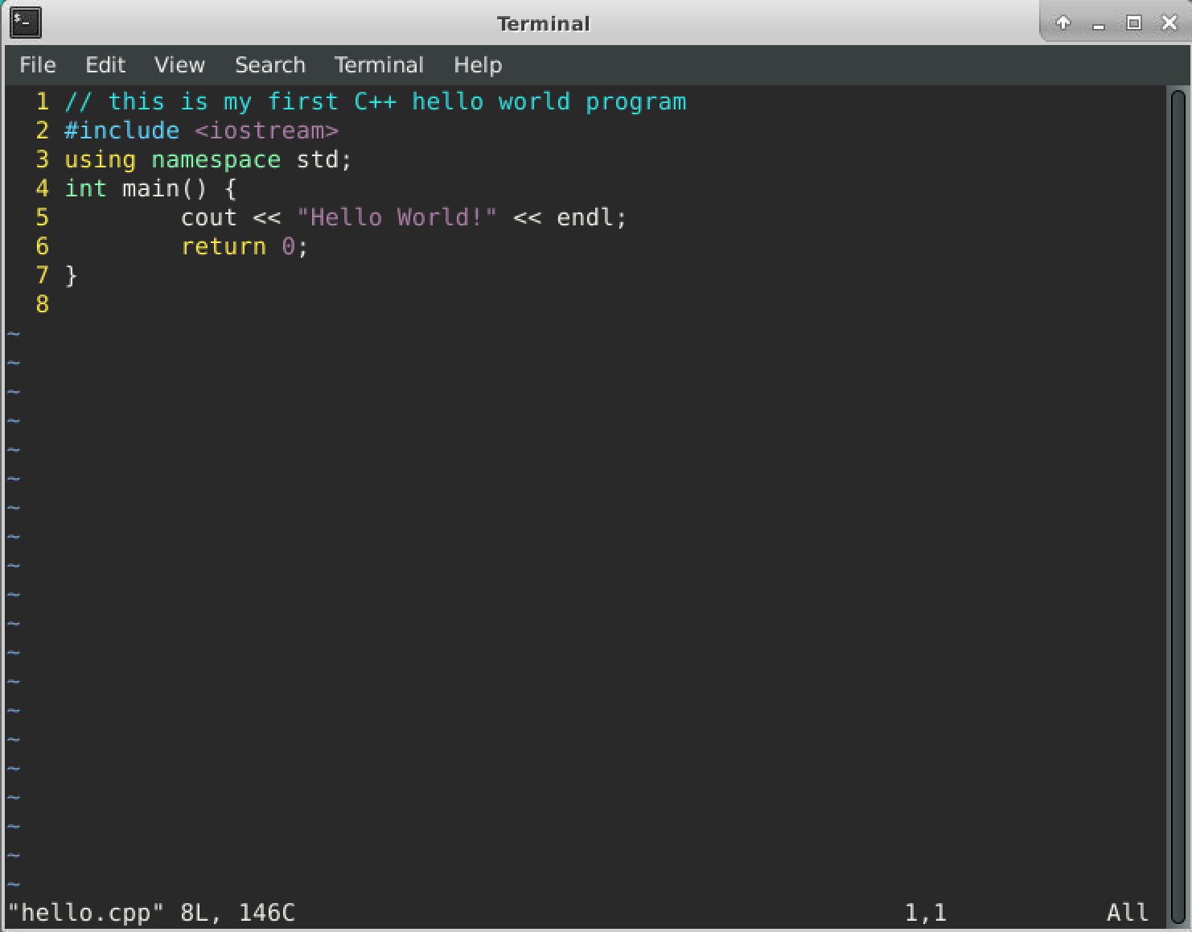
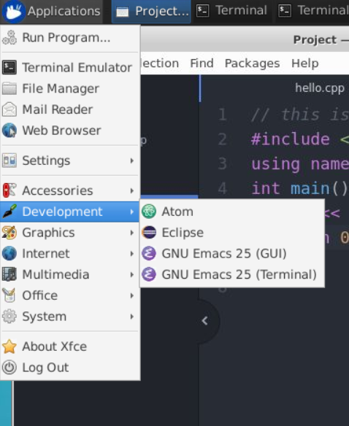
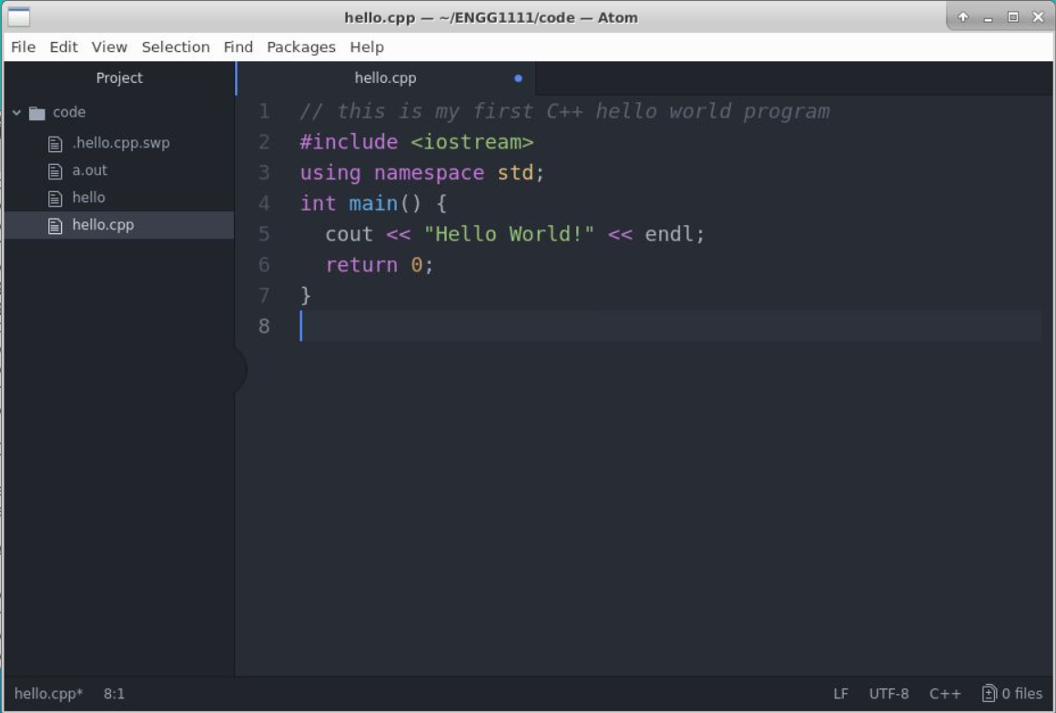
Program Editing
In the Ubuntu (Linux) environment that you have been working on for the previous modules, you may use the vi editor or the Atom editor (https://atom.io/) to edit your program. The Atom editor has a nice graphical user interface (GUI) and can be linked with the gcc compiler to facilitate coding.
hello.cpp in the Atom editor
hello.cpp in the vi editor
Atom is installed in CS server Ubuntu environment
<number>

Slide 11
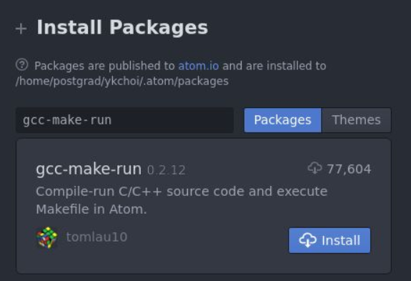
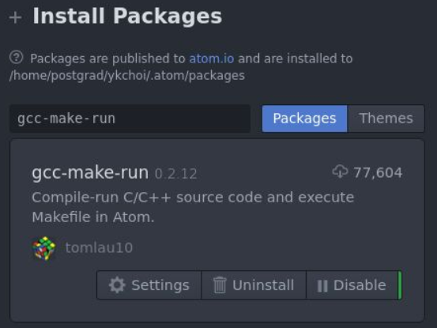
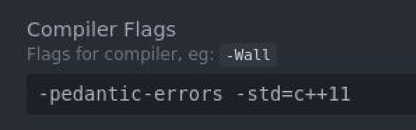
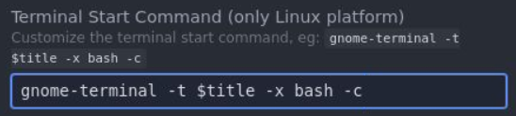
Compiling and Execution
With the Atom editor (in X2Go)
We need to install the gcc-make-run package so we can compile and execute a C/C++ program from within Atom
To do so, in the Atom editor, choose “Packages” -> “Settings View” -> “Install Packages/Themes” from the menu, and search for the “gcc-make-run” package.
Click “Install” and after installation is done, click on “Settings”
Under Compiler Flags, put down “-pedantic-errors -std=c++11”. This is the compiler options that we would use.
Under Terminal Start Command, put down “gnome-terminal -t $title -x bash -c” so that the terminal will fire up while executing your program for standard I/O.
<number>

Slide 12
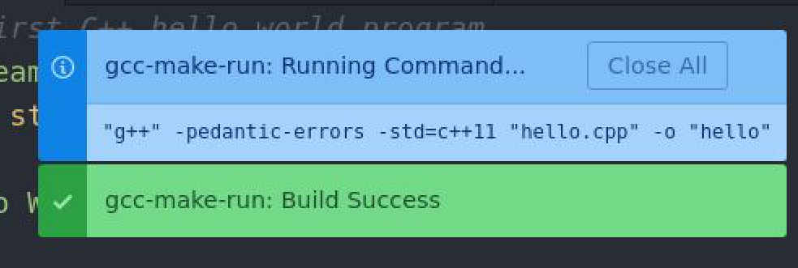
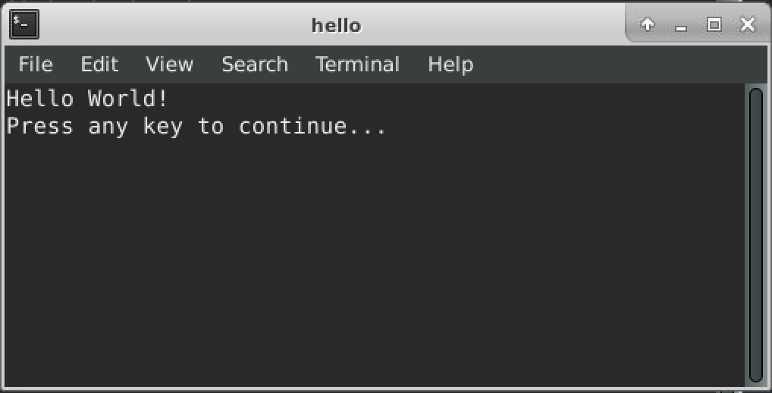
Compiling and Execution
With the Atom editor (in X2Go)
Open hello.cpp.
Press F6 to compile and run the program.
Note that the g++ command line with the flags will be displayed.
A terminal with the program output will be popped up if the compilation is successful.
Now try to remove “;” after “endl” in line 5. Compile and run the program again. What will happen?
<number>

Slide 13
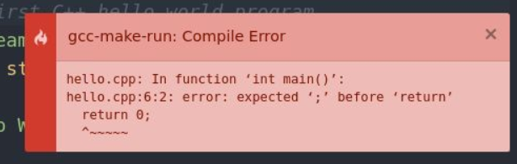
Compiling and Execution
You should get a compilation error.
Take a look at the error message.
It says “hello.cpp:6:2:”, so the error is around line 6.
Read further and it says “expected ‘;’”, so you probably know that is about a missing ‘;’
Now fix the error in the program and compile & run again.
Note: Sometimes the error message is not as “understandable” and “helpful” as this one. We’ll have some hints for you about debugging a C/C++ program.
<number>

Slide 14
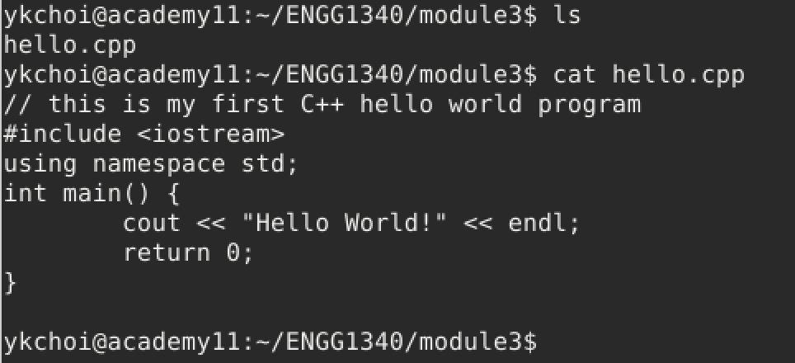
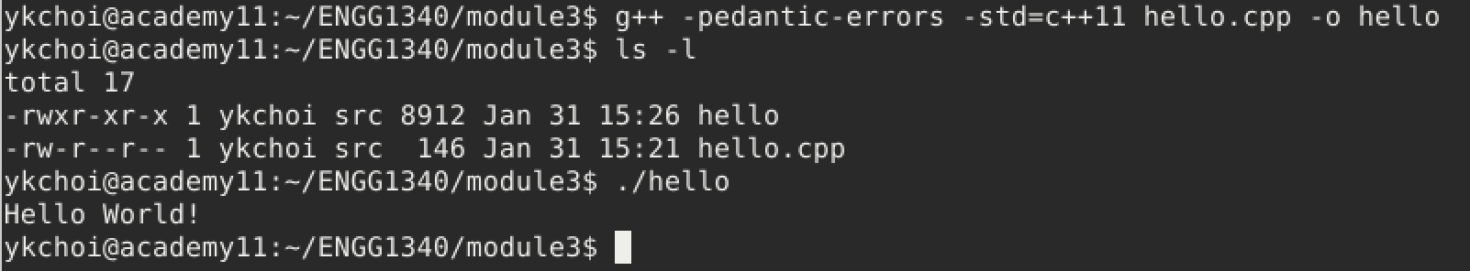
Compiling and Execution
With command line:
Sometimes you don’t have a nice GUI environment to work with, and you will have to rely on command line (via the terminal) for compiling and executing your program.
Now, suppose you already have hello.cpp in your current working directory.
Use this command line to compile hello.cpp: g++ -pedantic-errors -std=c++11 hello.cpp -o hello
If the compilation is successful, you should find another file “hello” in the working directory.
Run the executable “hello” by typing “./hello” at the prompt
<number>

Slide 15
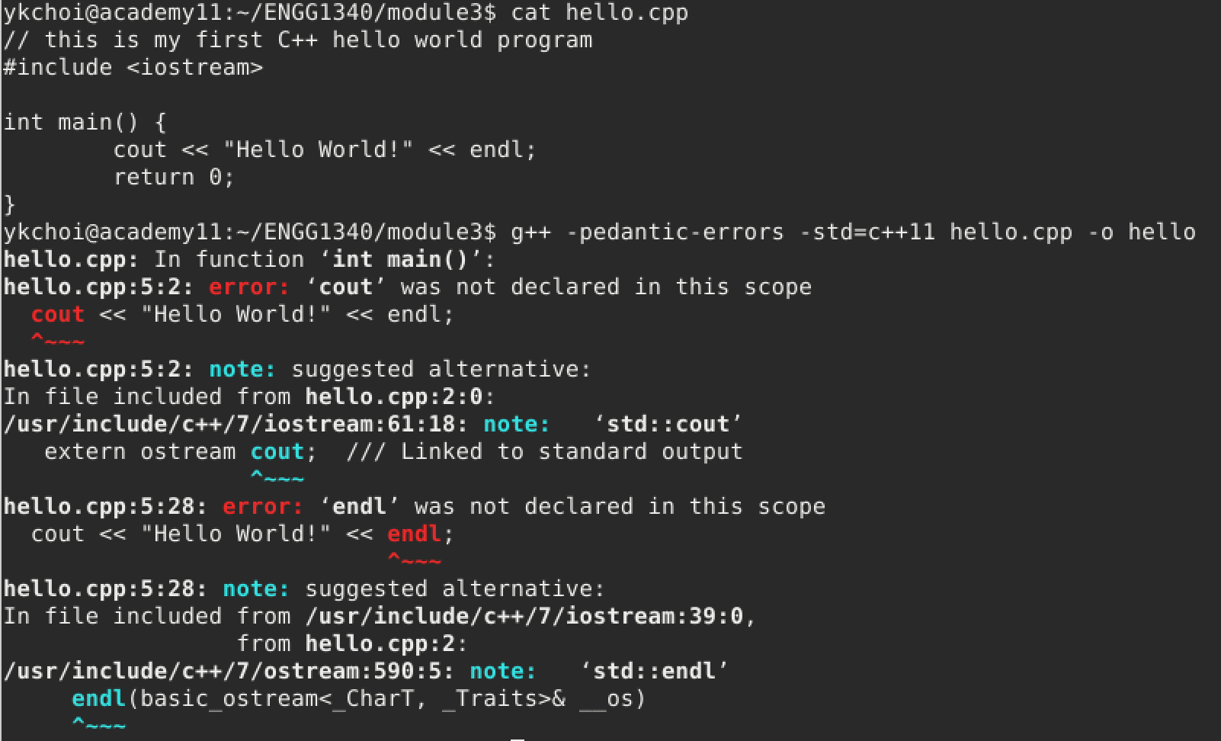
Compiling and Execution
With command line:
Now try again to mess up with your code.
Delete line 3 “using namespace std;”
Compile and run the executable, and note what the error message is.
<number>

Slide 16
Hints on Debugging
Hint 1: The line number of an error reported by the compiler may be incorrect. It is possible that the error is located before the reported line. After all, the compiler can only try its best to guess what you meant to write down
Hint 2: For the same above reason, the nature of an error reported by the compiler may be incorrect
Hint 3: If your source code has multiple errors, always fix the first error and recompile, and repeat the process until the compilation is successful. This is because error messages subsequent to the first one have a higher likelihood of being incorrect
<number>

Slide 17
The First C++ Program
The Hello World program gives the basic structure of a C++ program.
// this is my first C++ hello world program
#include <iostream>
using namespace std;
int main() {
cout << “Hello World!” << endl;
return 0;
}
A line starting with // is called a comment line, any text after // till the end of line is ignored by the compiler
This is the include directive which tells the compiler where to find information about certain routines used by the program;
iostream is the name of a library that contains the declarations of the routines (cout/endl) that handle input from the keyboard and output to the screen;
Later, you may also use other libraries (e.g., the math library by #include <math>
The iostream object/operation cout and endl are under the namespace std. If this line is removed, then you will need to write std::cout and std::endl without raising a compilation error.
(You can try and look for the error yourselves.)
This is the main function which contains the main body of the C++ program. In this case, we have two statements “cout…” and “return ..” in the main body. The main function is also the starting point of the program execution of all C++ program: the program is executed statement by statement starting from the first statement in this main function
<number>

Slide 18
The First C++ Program
// this is my first C++ hello world program
#include <iostream>
using namespace std;
int main() {
cout << “Hello World!” << endl;
return 0;
}
By looking at the output of this program, you probably can guess what this program does. How would you change the program so that it can output Hello ENGG1340! on the screen?
The last statement return 0; in the main function indicates (to the operating system) that the program ended successfully. Note that on C++ compilers and more recent C compilers (C99 onwards), the compiler will add this statement for you if you omit it.
<number>

Slide 19
The First C++ Program
// this is my first C++ hello world program
#include <iostream>
using namespace std;
int main() {
cout << “Hello World!” << endl;
return 0;
}
cout is the standard output stream object defined in the iostream library. The standard output is the screen by default.
We will come back to the basic I/O afterwards.
www.cplusplus.com is a good place to look for the definition and usage of the C++ constructs and functions.
You are highly recommended to go through the related topics in their tutorial as well: http://www.cplusplus.com/doc/tutorial/
<number>

Slide 20
Variables
Let’s start with how a variable can be defined in C/C++.
Suppose we need a variable named “width”
which is to store an integer.
This statement is called a declaration.
int width;
Variable type
Variable name (identifier)
Used to store data.
Data stored in a variable may change over time.
When we declare a variable, the computer will assign an appropriate number of memory cells in the main memory to each variable according to the type of data to be stored
<number>

Slide 21
Variables
What happens in the computer?
1
int main ( ) {
int width;
int height;
…
return 0;
}
Main Memory
width
A memory chunk for storing an integer will be created in the main memory and associated with the name “width”
2
int main ( ) {
int width;
int height;
…
return 0;
}
Main Memory
width
height
Recall that the execution starts from the main() function
<number>

Slide 22
Identifiers (Variable names)
An identifier must start with either
a letter (i.e., A to Z, and a to z), or
the underscore symbol (i.e., _)
The rest of the characters may be
letters (i.e., A to Z, and a to z),
digits (i.e., 0 to 9), or
the underscore symbol (i.e., _)
Meaningful identifiers make a program more readable
C++ is case-sensitive
e.g., radius, RADIUS, Radius, etc., are different
Cannot be a keyword in C++
int area;
int length;
int area = length*length;
vs.
int a;
int b;
int b= a*a;
<number>

Slide 23
C++ Keywords
Reserved words in C++ with predefined meanings.
CANNOT be used as names for variables or anything else.
asm | do | inline | return | typedef
auto | double | int | short | typeid
bool | dynamic_cast | log | signed | typename
break | else | long | sizeof | union
case | enum | mutable | static | unsigned
catch | explicit | namespace | static_cast | using
char | extern | new | struct | virtual
class | false | operator | switch | void
const | float | private | template | volatile
const_cast | for | protected | this | wchar_t
continue | friend | public | throw | while
default | goto | register | true
delete | if | reinterpret_cast | try
You are not required to memorize all these names. You will get to recognize most of them later on.
<number>

Slide 24


Valid identifiers
Which of the following identifiers are valid in C++?
a_man | 2008 | program.cc
const | year1-student | _oOOo_
an integer | change%2 | ABCx123
string | Days_of_Week | friend
cout | delete | cos
Words like cin, cout, string, and cos are NOT keywords in C++. They are defined in libraries required by the C++ language standard. Redefining these words, though allowed, can be confusing and thus should be avoided.
<number>
Notes:
most IDE will highlight the keywords.
<number>

Slide 25
Data Type of a Variable
Data type is an important concept when using a variable.
Tells the computer how to interpret the data stored in a variable
Determines the size of storage needed to store the data
Some basic data types in C++:
Name | Description | Size | Range
char | Character or small integer | 1 byte | 0 to 255
bool | Boolean value | 1 byte | True(1) or False(0)
int | Integer | 4 bytes | -2147483648 to 2147483648
double | Double precision floating point number | 8 bytes | 1.7e‐308 to 1.7e+308 (~15 digits) -1.7e‐308 to -1.7e+308 (~15 digits)
** The size and range of a particular data type depend on the system under which a program is compiled. The values shown above are those found on most 32-bit systems
<number>

Slide 26
Declarations
All variables must be declared before use
A declaration specifies a type, and contains a list of one or more variables of that type
Examples:
Syntax
type_name variable_name;
type_name variable_name_1, variable_name_2, …;
To declare two integer variables named “age” and “steps”
int age, steps;
char c;
bool win;
double height, width, length;
<number>

Slide 27
Assignment Statement
A variable may be initialized or its value can be changed at a later time after its declaration using an assignment statement
An assignment statement consists of a variable on the left-hand side of an equal sign, and a value or an expression on the right-hand side
Syntax
variable_name = expression;
int age;
double heights;
age = 5;
heights = 8 * age + 20.5;
a constant value
Example
an expression
<number>

Slide 28
Assigning Values to Variables
1
int main ( ) {
int width, height, area;
width = 5;
height = 4;
area = width * height;
return 0;
}
Main Memory
width
???
5
height
???
4
area
???
The variable height is uninitialized before use and the result is unpredictable.
20
2
Main Memory
int main ( ) {
int width, height, area;
width = 5;
area = width * height;
return 0;
}
???
width
5
height
???
area
???
<number>

Slide 29
Initializations
A variable that has not been given a value is said to be uninitialized, and will simply contain some “garbage value”
Using uninitialized variables in computations will give unexpected results, and thus should be avoided
A variable may be initialized in its declaration:
int age = 5, steps = age + 10;
char c = ‘Y’;
bool win = true;
double height = 120.5, length = 1.5e3;
A character constant is written as a character within single quotes.
Scientific notation
(floating point notation)
1.5e3 = 1.5 * 10³ = 1500
<number>

Slide 30
Strings – the Very Basics
Very often we need to work on textual information and this can be done in C++ using strings (C has a different handling of strings and we will discuss that later)
A string variable is just a variable containing a sequence of characters
Strings are not the one of the fundamental C++ data types but are so frequently needed that they are defined as a class within the standard library.
Include the <string> header when using strings in your program.
Sometimes you got no compilation error even if you don’t include the <string> header; it’s because it might be included in some standard libraries already, however, this depends on the implementation of the standard libraries and so it’s always a good practice to include it when using strings.
<number>

Slide 31
Strings – the Very Basics
#include <iostream>
#include <string>
using namespace std;
int main() {
string greeting = “Hi”, name = “ENGG1340”;
cout << greeting << “ “ << name << endl;
greeting = “Good morning”;
cout << greeting << “ “ << name << endl;
return 0;
}
Can you guess what the output is?
Hi ENGG1340
Good morning ENGG1340
We will come back to the more interesting operations of strings later.
<number>

Slide 32
Constants
Constants are expressions with a fixed value
Integers: 65 (decimal), 0101 (octal), 0x41 (hexadecimal)
Floating point numbers: 3.14159, 6e23, 1.6e-19, 3.0
Characters: ‘A’, ‘z’, ‘\n’ (newline), ‘’’ (’), ‘\\’ (\), ‘\?’ (?), ‘\101’ (‘A’, octal ASCII code), ‘\x41’ (‘A’, hex ASCII code)
Strings: “This is a string”, “” (empty string)
Boolean: true, false
Note that a character is enclosed within the single quotes ‘ ’ while a string is enclosed by the double quotes “ ”. We will come back to the differences between characters and strings in later modules. For now, you may think of a character as a single letter and a string as a sequence of letters.
For more details: http://www.cplusplus.com/doc/tutorial/constants/
<number>

Slide 33
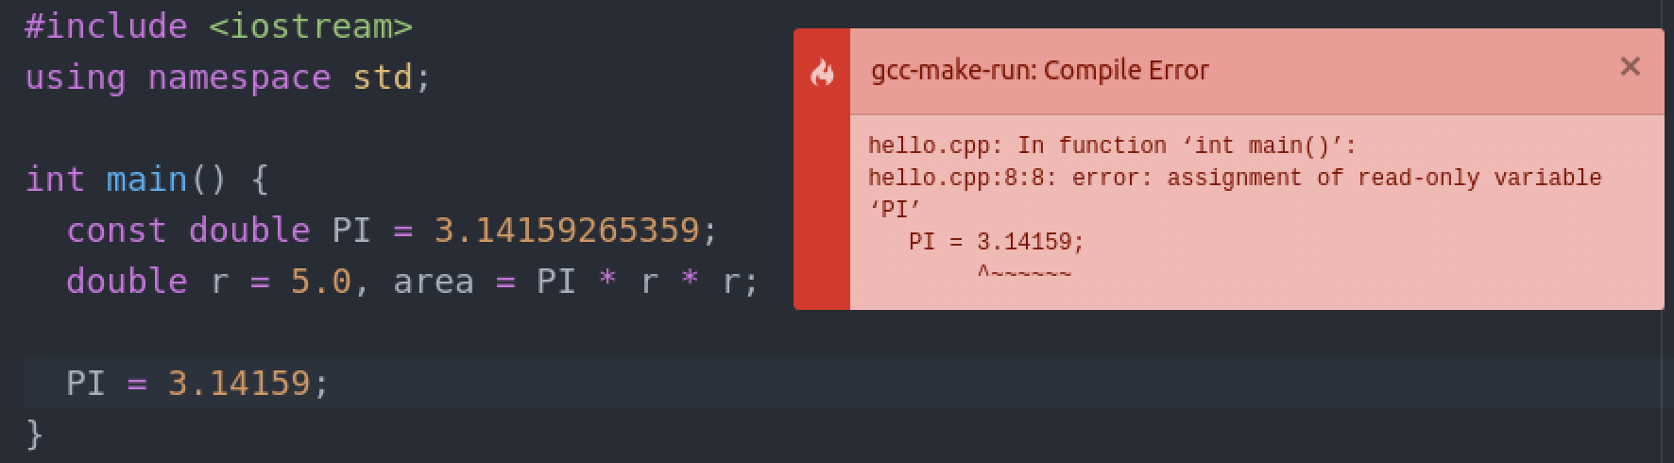
Constant Variables
Sometimes we want to assign a fixed value to a variable
Add a constant modifier in front of a variable declaration
The compiler will make sure that the variable remains a constant
double PI = 3.14159265359;
Line 8 “PI = 3.14159;” generates a compile error since PI is declared as a constant variable in line 5, but here we attempt to change its value
You can see that this helps to ensure the value of a variable will not be changed accidentally.
<number>
Notes:
What is this kind of error?
<number>

Slide 34
Expressions
Combine variables and constants to produce new values (i.e., to evaluate an expression)
Composed of operators (instructions) and operands (data)
Operators
Specify what is to be done on the operands
E.g., arithmetic operators, relational operators, logical operators
Operands
Data on which the computation is performed
May be variables and/or constants
operands
radius * 2 * 3.1416
operators
<number>

Slide 35
Operators
Arithmetic operators (+, –, *, /, %)
Relational operators (>, >=, <, <=, ==, !=)
Logical operators (&&, ||, !)
Increment and decrement operators (++, --)
Assignment operators (=, +=, -=, *=, /=)
<number>

Slide 36
Arithmetic Operators
Arithmetic Operators | Sign in the expression
Addition | +
Subtraction | -
Multiplication | *
Division | /
Modulus | %
The modulus operator % produces the remainder.
E.g., 13 % 3 results in 1
because 13 = (3 * 4) + 1
<number>

Slide 37
Arithmetic Operators
Note: when both operands of the / operator are of integer types, the / operator performs integer division which truncates any fractional part of the division result.
The operator % cannot be applied to double (i.e., floating point numbers).
int a = 3, b = 2;
int c = a / b, d = 8 / 3;
cout << "The value of c is " << c << endl ;
cout << "The value of d is " << d << endl ;
What is the screen output?
The value of c is 1
The value of d is 2
<number>

Slide 38
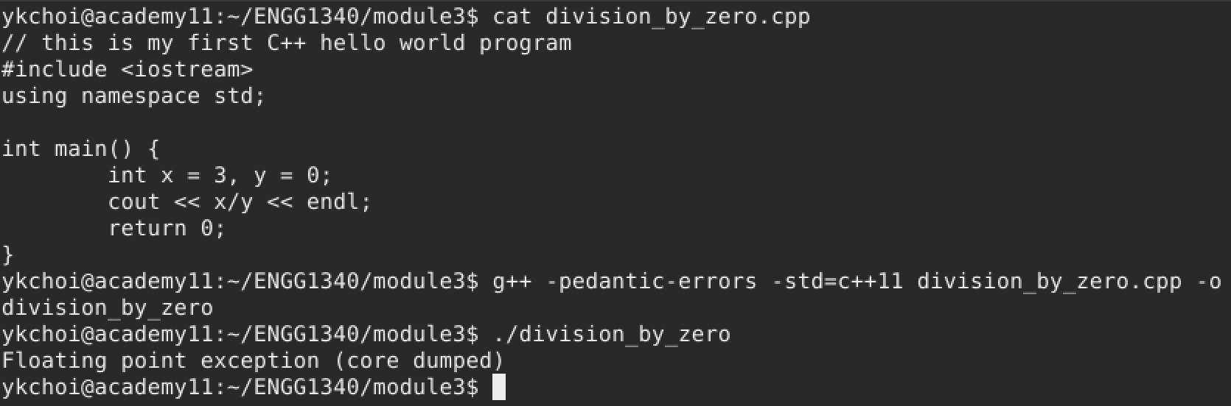
Division by Zero
If the divisor of the / operator is 0, a division by zero error will be generated during runtime.
Note that no compilation error will be generated.
<number>

Slide 39
Precedence
In evaluating an expression with mixed operators, those operators with a higher priority will be carried out before those with a lower priority.
The operator * has a higher precedence than the operator +.
The order of evaluation is equivalent to 1 + (2 * 3).
1 + 2 * 3
Result: 9 or 7?
✗
✓
<number>

Slide 40
Precedence
In evaluating an expression with mixed operators, those operators with a higher priority will be carried out before those with a lower priority.
The operator % has a higher precedence than the operator –.
The order of evaluation is equivalent to 12 – (11 % 3).
12 – 11 % 3
Result: 1 or 10?
✗
✓
<number>

Slide 41
Precedence & Associativity
Operator types | Operators | Associativity
unary | +, –, ++, --, ! | -
binary arithmetic | *, /, % | left to right
binary arithmetic | +, – | left to right
relational | <, <=, >, >= | left to right
relational | ==, != | left to right
logical | && | left to right
logical | || | left to right
assignment | =, +=, –=, *=, /=, %= | right to left
High precedence
Lower precedence
The order of evaluation may be overridden by inserting parentheses () into the expressions
e.g., (1 + 2) * 3 = 9
<number>

Slide 42
Arithmetic Operator for Characters
We may perform arithmetic operation with characters. In this case, the numerical representation as in the ASCII code for each character will be used in the calculation.
The following program also shows a common technqiues in converting a letter from upper case to lower case.
???
1: y
2: z
#include <iostream> using namespace std; int main()
{
char c = ‘Y’;
// convert a letter from upper case to lower case c = c – ‘A’ + ‘a’;
cout << "1: " << c << endl;
// advance to the next character c = c + 1;
cout << "2: " << c << endl;
return 0; }
Screen output
Can you convert a letter from lower case to upper case then?
The ASCII table:
www.asciitable.com
<number>

Slide 43
Relational Operators
Relational Operators | Sign in the expression
Greater than | >
Greater than or equal | >=
Smaller than | <
Smaller than or equal | <=
Equal | ==
Not equal | !=
same higher precedence
lower precedence
For comparing the operands.
<number>

Slide 44
Relational Operators
In C/C++, the numeric value of a relational or logical expression is 1 if the relation is true, and 0 if the relation is false.
???
cout << (a == b);
0
Suppose all 3 examples start with:
int a = 1, b = 2;
1
???
cout << (a > b);
0
2
???
cout << (a < b);
1
3
<number>

Slide 45
Relational Operators
int i = 1, lim = 2;
cout << (i < lim – 2) ;
???
0
4
The “–” operator is of higher precedence than the “<” operator, so “lim – 2” is executed first
int i = 1, lim = 2;
cout << ( (i < lim) – 2 );
???
-1
5
The bracket () overrides precedence and associativity, hence (i < lim) is first evaluated to yield the intermediate result 1
<number>

Slide 46
Logical Operators
Operands |  | AND (&&) | OR (||) | NOT (!)
A | B | A && B | A || B | ! A
0 | 0 | 0 | 0 | 1
0 | 1 | 0 | 1
1 | 0 | 0 | 1 | 0
1 | 1 | 1 | 1
0: False
1: True
Precedence: (High) ! > && > || (Low)
C++ treats any non-zero value as true, and zero as false
Hence (3 && 0) is false, and (-5 || 0) is true
The unary negation operator ! converts a non-zero operand into 0, and a zero operand into 1 (e.g., ! 3 is evaluated to 0)
<number>

Slide 47
Logical Operators
int x = 5;
bool in_range = ! (x < 0 || x > 50);
cout << in_range << endl;
???
1
1
Both expressions connected by || evaluate to a false value (0)
bool i_am_cool = (gals != 0) && ((gifts / gals) >= 2);
2
No! Because: C/C++ evaluates a logical expression from left to right, and stops evaluating once the truth or falsehood of the result is known.
(a.k.a. short-circuit evaluation)
What if gals is 0? Will gifts/gals generate a runtime error?
Hence, if gals is 0, the expression ((gals != 0) && ???) must be false anyway, so the expression (gifts / gals) >=2 will NOT be evaluated, and thus not generating a runtime error.
There is similar short-circuit evaluation for the || operator: bool omg = (gals == 0) || ((gifts / gals) < 2);
<number>

Slide 48
Increment & Decrement Operators
Assignment Operators | Sign in the expression
Increment | ++
Decrement | --
The increment operator ++ adds 1 to its operand.
The decrement operator -- subtracts 1 from its operand.
int i = 0;
++i ;
int i = 0;
i = i + 1;
is equivalent to
int i = 0;
--i ;
int i = 0;
i = i – 1;
is equivalent to
<number>

Slide 49
Increment & Decrement Operators
The operators ++ and -- may be used either as prefix (e.g., ++i) or postfix (e.g., i++) operators.
When used as prefix, increment/decrement is done before the value is used.
When used as postfix, increment/decrement is done after the value is used.
int c = 0, i = 0; c = ++i ;
int c = 0, i = 0; i = i + 1; c = i;
c = ??? i = ???
is equivalent to
int c = 0, i = 0; c = i++;
int c = 0, i = 0; c = i;
i = i + 1;
c = ??? i = ???
is equivalent to
<number>

Slide 50
Assignment Operators
Expression such as i=i+2 in which the variable on the left-hand side is repeated immediately on the right can be written in the compressed form i+=2
Most binary operators have a corresponding compound assignment operator, e.g., -=, *=, /=, and %=
Examples
x *= y + 1;
is equivalent to
x = x * (y + 1);
x %= y % 3;
is equivalent to
x = x % (y % 3);
<number>

Slide 51
Type Conversions
When an operator has operands of different types, they are converted to a common type according to a small number of rules.
1
“lower” type promoted to “higher” type
3.0 / 2;
2 (int) is promoted to 2.0 (double), and the result is 1.5
Important: Compare this with
3 / 2;
No type conversion because both 3 and 2 are integers, therefore integer division is carried out, and the result is 1
<number>

Slide 52
Type Conversions
2
In assignment statements, the value of the right side is converted to the type of the left
double x = 5;
x stores the value 5.0
int x = 2.8;
Converting a double value to an int value causes truncation of any fractional part
x stores the value 2
* The compiler may issue a warning as there is information loss.
int x = (int) 2.8;
Explicit type casting tells the compiler it is an intended type conversion and prevents the compiler from producing a warning. x stores the value 2
* The compiler generates no warning
This also shows that you, as the programmer, can control how values are stored.
<number>

Slide 53
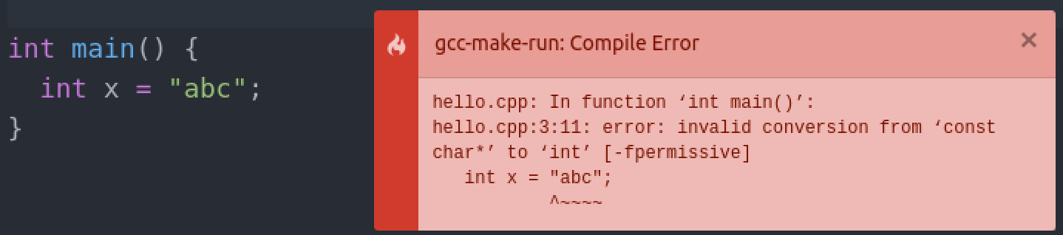
Type Conversions
3
Type conversions that don’t make sense are not allowed.
e.g., assigning a string literal to an int variable generates a compilation error:
<number>

Slide 54
Basic I/O (Input/Output)
A stream is an object where a program can either insert or extract characters to/from it.
We may use streams to perform input and output operations in sequential media such as the screen or the keyboard.
The standard C++ library includes the header file iostream where the standard input and output stream objects are declared.
We need to include the header file by the #include directives before using any objects and functions in the iostream library.
#include <iostream>
using namespace std;
int main () { … }
Include the iostream library to use cin and cout. The iostream library is some existing object codes developed by others. As this is so useful, it is regarded as standard C++ library.
<number>

Slide 55
Basic I/O
#include <iostream>
using namespace std;
int main () { cout << “Hello!” << endl; }
This statement is important!
Because cout and endl are provided under the namespace (i.e., a container of names) std. Their names are indeed std::cout and std::endl.
✗
✓
#include <iostream>
int main () { cout << “Hello!” << endl; }
#include <iostream>
int main () { std::cout << “Hello!” << std:: endl; }
a.cpp: In function int main():
a.cpp:4: error: 'cout' was not declared in this scope a.cpp:4: error: 'endl' was not declared in this scope
Compiler error
<number>

Slide 56
Standard Output
By default, the standard output of a program is the screen, and the C++ stream object defined to access it is cout.
The insertion operator << is used to insert data into the stream, which may be used more than once in a single statement.
Hello
World!
int a = 1 , b= 2, c = 3;
cout << “Hello ”; cout << “World!” << endl;
cout << 1 << a << endl;
cout << “b = ” << b << “ and c = ” << c << endl;
11
b = 2 and c = 3
Screen output
Note that there is no line break after “Hello ” and “World!”
Also there is no space between 1 and the value of a in the 2nd output line.
<number>

Slide 57
Standard Output
There are some escape sequences that have special usage in the output.
\a | alert (bell) character | \v | vertical tab
\b | backspace | \\ | backslash
\n | newline | \? | question mark
\r | carriage return | \’ | single quote
\t | horizontal tab | \” | double quote
cout << a << endl;
cout << “Hi!” << endl;
cout << a << ‘\n’;
cout << “Hi!\n”;
is equivalent to
Try out these escape sequences in a program and see the result!
<number>

Slide 58
Standard Input
From time to time, we need to obtain user input to our program.
The standard input device is usually the keyboard, and the C++ stream object defined to access it is cin.
The extraction operator >> is used to extract data from the stream
The type of the variable will determine the type of data that is extracted from the stream.
Note that cin can only process the input from the keyboard once the RETURN key has been pressed.
int x;
cin >> x;
char x;
cin >> x;
vs.
An integer is expected to be input
A character is expected to be input
<number>

Slide 59
A Sample Program on I/O
Be careful about the directions of the << and >> operators!
#include <iostream>
using namespace std;
int main(){
int age;
double height, weight;
cout << "Please input your age, height and weight: ";
cin >> age >> height >> weight;
cout << endl << "Your age is " << age << endl;
cout << "Your height is " << height << endl;
cout << "Your weight is " << weight << endl;
return 0;
}
Please input your age, height and weight:
Screen output
<number>

Slide 60
A Sample Program on I/O
#include <iostream>
using namespace std;
int main(){
int age;
double height, weight;
cout << "Please input your age, height and weight: ";
cin >> age >> height >> weight;
cout << endl << "Your age is " << age << endl;
cout << "Your height is " << height << endl;
cout << "Your weight is " << weight << endl;
return 0;
}
user input from keyboard
Please input your age, height and weight:
Please input your age, height and weight: 20 175.5 132
Screen output
<number>

Slide 61
A Sample Program on I/O
#include <iostream>
using namespace std;
int main(){
int age;
double height, weight;
cout << "Please input your age, height and weight: ";
cin >> age >> height >> weight;
cout << endl << "Your age is " << age << endl;
cout << "Your height is " << height << endl;
cout << "Your weight is " << weight << endl;
return 0;
}
Please input your age, height and weight: 20 175.5 132
Please input your age, height and weight: 20 175.5 132
Your age is 20
Your height is 175.5
Your weight is 132
Screen output
<number>

Slide 62
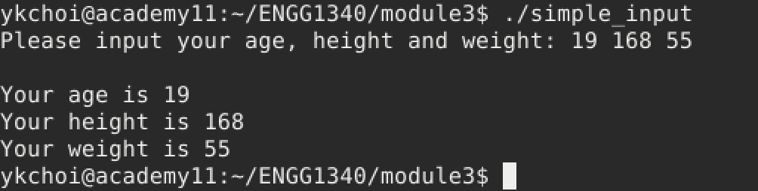
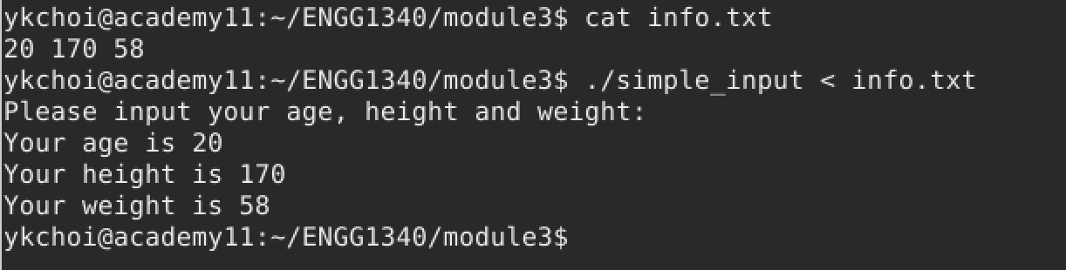
Using File Redirection as Standard Input to Your Program
Sometimes it is just too tiring to enter the input values to your program again and again, especially during the testing and debugging stages. In this case, you may execute your program using command line and file redirection so that the contents of a file will be fed into your program as if they are from the standard input (i.e., by default the keyboard)
User input from keyboard
User input stored in a file “info.txt” and use file redirection to fed file contents to the program as input.
<number>

Slide 63
Part II
Flow of Control
<number>

Slide 64
What we are going to learn?
Making decisions in your program (branching)
the if selection statement
the if…else double selection statement
the switch multiple-selection statement
Doing something repeatedly (looping)
while loop
for loop
break and continue in loops
<number>

Slide 65
Algorithms
An algorithm is a procedure for solving a problem in terms of
the actions to execute and
the order in which the actions execute (flow of control)
Get out of bed
Get out of bed
Flow of control is important. The correctness of your algorithm determines whether you can get the desired result.
Take off pajamas
Take off pajamas
Take a shower
Get dressed
Get dressed
Take a shower
✓
✗
Go to campus
Go to campus
<number>

Slide 66
Reference Only
Pseudocode
“fake” code—An artificial and informal language similar to everyday English for developing an algorithm
Helps you think out a program without worrying the syntax of a programming language.
Problem: Adding two input integers
A C++ Program
Pseudocode
cout << “Please input the 1st integer:”; cin >> x; cout << “Please input the 2nd integer:”; cin >> y;
int res = x + y; cout << res << endl;
Prompt the user to enter the 1st integer
Input the 1st integer
Prompt the user to enter the 2nd integer
Input the 2nd integer
Add 1st integer and 2nd integer, store result
Display result
<number>
Notes:
<number>

Slide 67
Flowchart
A diagram to illustrate program flow (program logic).
Used in analyzing, designing, documenting or managing a program.
Input the second integer
Prompt the user to enter the first integer
Add first integer and second integer, store result
Input the first integer
Prompt the user to enter the first integer
Prompt the user to enter the second integer
<number>

Slide 68
Flow of Control
Recall that statements in the main function are executed sequentially.
In more complex programs, however, it is often necessary to alter the order in which statements are executed, e.g.,
Choosing between two alternative actions – branching
Repeating an action a number of times – looping
The order in which statements are executed is often referred to as flow of control
<number>

Slide 69
Branching & Looping
Compile program
Wake up
Fix the first syntax error
Typhoon #8?
N
Y
Compilation Error?
Y
N
Go to campus
Go to bed again
Run program
Branching
Looping
<number>

Slide 70
Make a decision
Branching
<number>

Slide 71
Making a Decision
Sometimes an action is taken selectively based on a decision/condition.
Get dressed
Does it rain?
Y
Bring an umbrella
A condition
N
Go to campus
Do this only when the condition is true
<number>

Slide 72
The if statement
Pseudocode
If student’s mark is greater than or equal to 60
print “passed”
C++ code
mark >= 60?
if (mark >= 60) cout << “passed”;
Y
Print “passed”
N
Flowchart
<number>
Notes:
Write a program here to show how to compose the entire program from this program segment
<number>

Slide 73
The if statement
Syntax
if (condition) statement;
condition: an expression that evaluates to true or false
statement: a statement to execute if condition is true
mark > 60
‘A’ == ‘a’
3 – 2 != 0
3 – 2
<number>

Slide 74
The if…else statement
Pseudocode
If student’s mark is greater than or equal to 60
print “passed”
Else
print “failed”
C++ code
mark >= 60?
if (mark >= 60) cout << “passed”;
else cout << “failed”;
Y
N
Print “failed”
Print “passed”
Flowchart
<number>

Slide 75
The if…else statement
Syntax
if (condition) statement1;
else
statement2;
condition: an expression that evaluates to true or false
statement1 is executed if condition is true; and if condition is false, statement2 is executed.
<number>

Slide 76
Example 1
Write a program that reads 2 input integers and outputs the bigger one.
#include <iostream>
using namespace std;
int main() {
return 0;
}
How would you solve the problem?
First step: devise a logical flow (i.e., the algorithm) for the solution.
Always start with this template for writing a program with standard I/O
<number>

Slide 77
Example 1
Write a program that reads 2 input integers and outputs the bigger one.
Read 2 integers: a and b
#include <iostream>
using namespace std;
int main() {
return 0;
}
a > b?
Y
N
max = b
max = a
Always start with this template for writing a program with standard I/O
Output max
<number>
Notes:
<number>

Slide 78
Example 1
Write a program that reads 2 input integers and outputs the bigger one.
Read 2 integers: a and b
#include <iostream>
using namespace std;
int main() {
return 0;
}
a > b?
Y
N
Now think about it:
How many variables do you need?
What are their data types?
Remember to declare and initialize the variables before using them.
max = b
max = a
Output max
<number>

Slide 79
Example 1
Write a program that reads 2 input integers and outputs the bigger one.
Read 2 integers: a and b
#include <iostream>
using namespace std;
int main() {
return 0;
}
a > b?
Y
int a, b, max; cin >> a >> b;
N
max = b
max = a
if (a > b) max = a;
else
max = b;
Output max
cout << max;
<number>
Notes:
<number>

Slide 80
Example 2
Read 3 integers: a, b and c
Write a program that reads 3 input integers and outputs the maximum one.
a > b?
#include <iostream>
using namespace std;
int main() {
return 0;
}
Y
N
max = b
max = a
Let’s first come up with an algorithm to solve the problem.
max > c ?
Y
N
Output c
Output max
<number>

Slide 81
Example 2
Read 3 integers: a, b and c
Write a program that reads 3 input integers and outputs the maximum one.
a > b?
#include <iostream>
using namespace std;
int main() {
return 0;
}
Y
N
int a, b, c, max; cin >> a >> b >> c;
max = b
max = a
if (a > b) max = a;
else
max = b;
max > c ?
Y
if (max > c) cout << max << endl;
else
cout << c << endl;
N
Output c
Output max
<number>

Slide 82
Compound Statements
What if an action involves more than one statement?
Syntax
if (condition) statement;
mark >= 60?
Y
grade = ‘P’
a statement can also be a compound statement or a block of statements enclosed in { and }
N
Print “passed”
if (mark >= 60) { grade = ‘P’; cout << “passed”;
}
<number>

Slide 83
Compound Statements
mark >= 60?
if (mark >= 60) {
grade = ‘P’; cout << “passed”;
}
else {
grade = ‘P’; cout << “failed”;
}
Y
N
grade = ‘F’
grade = ‘P’
Print “failed”
Print “passed”
<number>

Slide 84
Nested if…else Statements
Age within [18, 25]?
Y
An if-else statement can be nested within another if-else statement
N
Height >=180?
Y
N
“Bye bye”
“I am sorry”
“Yes I do!”
My Mr. Right…
1. 18 to 25 years old, AND 2. Height: 180 cm or above
<number>

Slide 85
Nested if…else Statements
age within [18, 25]?
…
if (age >= 18 && age <=25) {
// the Yes part to
// be dealt with here
}
else {
cout << "Bye bye.";
}
…
Y
N
height >=180?
Y
N
“Bye bye”
“I am sorry”
“Yes I do!”
My Mr. Right…
1. 18 to 25 years old, AND 2. height: 180 cm or above
<number>

Slide 86
Nested if…else Statements
age within [18, 25]?
…
if (age >= 18 && age <=25) {
if (height >= 180) cout << "Yes I do!"; else cout << "I am sorry.";
}
else {
cout << "Bye bye.";
}
…
Y
N
height >=180?
Y
N
“Bye bye”
“I am sorry”
“Yes I do!”
My Mr. Right…
1. 18 to 25 years old, AND 2. height: 180 cm or above
<number>

Slide 87
A Note on Block Statement in C/C++ vs. Python
How do you specify a block statement in Python?
In C/C++ , we use {} to specify a block instead
Indeed, the C/C++ compiler does not care about indentation which means that you can write in as few lines as possible, as long as the compiler can parse it.
if mark >= 60:
grade = "P" print("passed")
else:
grade = "P" print("failed")
if (mark >= 60) {
grade = ‘P’; cout << “passed”;
}
else {
grade = ‘P’; cout << “failed”;
}
Python: Indentation
C/C++: { }
Try this: a C++ program in 2 lines
#include<iostream>
int main() {if (2>3) std::cout << "no way"; else std::cout << "Why do you desperately need to make life harder?\n"; return 0;}
<number>

Slide 88
Coding Hints
Visualize the logic of the program before writing the code.
When writing the code, follow the logic in the diagram, implement the processes in the diagram one at a time.
Use proper indentation (spacing) to make your program more human readable (even when C/C++ does not require this). Always remember that you or others will need to maintain your codes later.
<number>

Slide 89
Dangling-Else Problem
Unlike Python, indentation does NOT determine blocks of statements in C/C++!
The following program segments are treated the same by the C/C++ compiler, although they have different indentations as appear to us. So how would the C/C++ treat it? Should the else be paired with the 1st if or the 2nd if?
if ( x > 5 )
if ( y > 5 )
cout << “x and y are > 5”; else
cout << “x is <= 5”;
Looks as if: 1st cout is executed when x > 5 and y > 5, 2nd cout is executed when x <= 5
if ( x > 5 )
if ( y > 5 )
cout << “x and y are > 5”; else
cout << “x is <= 5”;
Looks as if: 1st cout is executed when x > 5 and y > 5,
2nd cout is executed when x > 5 and y <= 5
✓ this is what the compiler treats as
<number>

Slide 90
Dangling-Else Problem
Recall that C++ is a free formatting language
The compiler will ignore any whitespaces, including indentations
The compiler always pairs an else with the nearest previous if that is not already paired with some else
To avoid the dangling else problem, use braces { } to tell the compiler how to group the statements
<number>

Slide 91
Dangling-Else Problem
if ( x > 5 )
if ( y > 5 )
cout << “x and y are > 5”; else
cout << “x is <= 5”;
if ( x > 5 ) {
if ( y > 5 )
cout << “x and y are > 5”; else
cout << “x is <= 5”; }
is equivalent to
If you want the 2nd cout to be executed when x <= 5:
if ( x > 5 ) {
if ( y > 5 )
cout << “x and y are > 5”; } else
cout << “x is <= 5”;
<number>

Slide 92
A Dangling-Else Example
if ( temperature >= 20 )
if ( temperature >= 30 )
cout << “good day for swimming” << endl; else
cout << “good day for golfing” << endl; else
cout << “good day to play tennis”;
1
How to pair up the if’s and else’s?
2
Conditions for swimming, golfing & tennis?
temperature >= 30
20 <= temperature < 30
temperature < 20
<number>

Slide 93
Multi-way if-else Statement
mark >=90?
Y
Print “A”
N
if ( mark >= 90 ) // 90 and above gets "A" cout << "A";
else
if ( mark >= 80 ) // 80-89 gets "B"
cout << "B";
else
if (mark >= 70 ) // 70-79 gets "C"
cout << "C";
else
if (mark >= 60 ) // 60-69 gets "D"
cout << "D";
else // less than 60 gets "F"
cout << "F";
mark >=80?
Y
Print “B”
N
mark >=70?
Y
Print “C”
N
mark >=60?
Y
Print “D”
N
Print “F”
<number>

Slide 94
Multi-way if-else Statement
mark >=90?
Y
Print “A”
A more compact style is preferred
N
if ( mark >= 90 ) // 90 and above gets "A" cout << "A";
else if (mark >= 80 ) // 80-89 gets "B"
cout << "B";
else if (mark >= 70 ) // 70-79 gets "C"
cout << "C";
else if (mark >= 60 ) // 60-69 gets "D"
cout << "D";
else // less than 60 gets "F"
cout << "F";
mark >=80?
Y
Print “B”
N
mark >=70?
Y
Print “C”
N
mark >=60?
Y
Print “D”
N
Print “F”
<number>

Slide 95
Series of if vs. Multi-way if-else
What’s the difference between the following two program segments?
if (mark >= 90 ) cout << "A";
else if (mark >= 80 )
cout << "B";
else if (mark >= 70 )
cout << "C";
else if (mark >= 60 )
cout << "D";
else
cout << "F";
if ( mark >= 90 )
cout << "A";
if ( mark < 90 && mark >= 80 )
cout << "B";
if ( mark < 80 && mark >= 70 )
cout << "C";
if ( mark < 70 && mark >= 60 )
cout << "D";
if ( mark < 60 )
cout << "F";
Faster, skip remaining if testing once hitting a true condition
Slower, needs to test all conditions even though only one of them can be true
Same program outcome but different performance!
<number>

Slide 96
switch Statement
Syntax
switch (controlling_expression) {
case constant_1:
statement_1;
break;
case constant_2:
statement_2;
break;
...
case constant_n:
statement_n;
break;
default:
default_statement;
}
A multi-way branching action can also be achieved using a switch statement
The controlling expression in a switch statement must return either a Boolean value, an integer or a character
optional
<number>

Slide 97
switch Statement
1
When a switch statement is executed, the controlling_expression is evaluated,
the value of which must be one of Boolean, integer or character types
char grade;
cin >> grade;
switch ( grade ) { case ‘A’:
cout << "grade point is 4.0"; break;
case ‘B’:
cout << "grade point is 3.0"; break;
case ‘C’:
cout << "grade point is 2.0";
break;
case ‘D’:
cout << "grade point is 1.0";
break;
case ‘F’:
cout << "grade point is 0.0";
break;
default:
cout << "grade is invalid";
}
2
The constants given after the case keywords are checked in order until the first that equals the value of the controlling_expression is found, and then the following statements are executed
3
The switch statement ends when a break statement is encountered
4
If none of the constants matches the value of the controlling_expression, then the default_statement is executed
<number>

Slide 98
switch Statement
char grade;
cin >> grade;
switch ( grade ) { case ‘A’:
cout << "grade point is 4.0"; break;
case ‘B’:
cout << "grade point is 3.0"; break;
case ‘C’:
cout << "grade point is 2.0";
break;
case ‘D’:
cout << "grade point is 1.0";
break;
case ‘F’:
cout << "grade point is 0.0";
break;
default:
cout << "grade is invalid";
}
is equivalent to
char grade;
cin >> grade;
if (grade == ‘A’) cout << "grade point is 4.0"; else if (grade == ‘B’)
cout << "grade point is 3.0"; else if (grade == ‘C’)
cout << "grade point is 2.0";
else if (grade == ‘D’)
cout << "grade point is 1.0";
else if (grade == ‘F’)
cout << "grade point is 0.0";
else
cout << "grade is invalid";
The switch statement is sometimes preferably especially when it can show clearly the flow of control depends on the value of grade only.
<number>

Slide 99
switch Statement
more examples
switch ( mark / 10 ) { case 0: case 1:
case 2: case 3:
case 4: case 5:
grade = ‘F’;
break;
case 6:
grade = ‘D’;
break;
case 7:
grade = ‘C’;
break;
case 8:
grade = ‘B’;
break;
case 9:
case 10:
grade = ‘A’;
break;
default:
cout << “invalid mark";
}
Assuming that mark is of type int with range 0 to 100. Note that this is an integer division which results in an integer value.
What is the range of mark for grade to be assigned ‘A’?
for grade to be assigned ‘B’?
for grade to be assigned ‘C’?
for grade to be assigned ‘D’?
for grade to be assigned ‘F’?
What if mark is out of the range 0 to 100?
90-100
80-89
70-79
60-69
0-59
The program will output “invalid mark” on screen
<number>

Slide 100
switch Statement
more examples
switch ( age >= 18 ) { case 1:
cout << “Old enough to vote"; break;
case 0:
cout << “Not old enough to vote"; break;
}
What is the program output?
If age >= 18 is true, then output “Old enough to vote” to screen;
Otherwise output “Not old enough to vote” to screen
<number>

Slide 101
int main()
{
int mark;
cout << “Enter the mark: ”;
cin >> mark;
switch ( mark / 10 ) { case 0: case 1:
case 2: case 3:
case 4: case 5:
cout << “The grade is F.” << endl;
break;
case 6:
cout << “The grade is D.” << endl;
break;
case 7:
cout << “The grade is C.” << endl;
break;
case 8:
cout << “The grade is B.” << endl;
break;
case 9:
case 10:
cout << “The grade is A.” << endl;
break;
default:
cout << “Invalid mark.“ << endl;
}
return 0;
}
switch Statement more examples
A recap
What is the output of the program segment if the input mark is 75?
Enter the mark: 75
The grade is C.
<number>

Slide 102
switch Statement more examples
int main()
{
int mark;
cout << “Enter the mark: ”;
cin >> mark;
switch ( mark / 10 ) { case 0: case 1:
case 2: case 3:
case 4: case 5:
cout << “The grade is F.” << endl;
case 6:
cout << “The grade is D.” << endl;
case 7:
cout << “The grade is C.” << endl;
case 8:
cout << “The grade is B.” << endl;
case 9:
case 10:
cout << “The grade is A.” << endl;
default:
cout << “Invalid mark.“ << endl;
}
return 0;
}
Pay ATTENTION! The break; statements are missing!
What is the output of the program segment if the input mark is 75?
Enter the mark: 75
The grade is C. The grade is B.
The grade is A.
Invalid mark.
<number>

Slide 103
Common Mistakes
Below are some common mistakes in the Boolean condition of an if or if…else statement:
Using an assignment instead of the equality operator, e.g.,
Using bitwise AND/OR instead of logical AND/OR operator, e.g.,
Using strings of inequalities, e.g.,
These are all legal expressions in C++ and hence the compiler will not report any syntax error
if (a = 10)
✗
if (a == 10)
✓
if (a != 0 & b > 0)
if (a != 0 && b > 0)
✗
✓
if (a != 0 | b > 0)
if (a != 0 || b > 0)
if (a < b < c)
✗
if (a < b && b > c)
✓
<number>

Slide 104
?: — A Shorthand for If-Else
A ternary operator that takes three operands:
condition ? expr1 : expr2
A conditional expression that evaluates to a value:
if condition is true, expr1 is the value of the expression
if condition is false, expr2 is the value of the expression
if (mark >= 60) cout << “passed”;
else cout << “failed”;
is equivalent to
cout << ((mark >= 60)? “passed” : “failed”);
Note: if…else is a statement, ?: is an operator that forms an expression
<number>

Slide 105
Doing something repeatedly
LOOPING
<number>

Slide 106
Loop
A loop is any program construction that repeats a statement (or a compound statement) a number of times
The statement to be repeated in a loop is called the body of the loop
Each repetition of the loop body is called an iteration
In C++, looping can be achieved using either a while statement or a for statement
Note: There is also the do…while statement, but we will leave it for you interest only.
<number>

Slide 107
while Statement
Loop body
loop condition
true
statement(s)
false
The while statement controls whether to repeat a loop body depending on a condition. Essentially, the loop body is executed repeatedly as long as condition is true
while (condition) { statement_1;
statement_2;
…
statement_n;
}
1
1
execution path when condition is true
2
2
execution path when condition is false
<number>

Slide 108
while Statement
Syntax
while (condition) statement;
Syntax
while (condition) { statement_1;
statement_2;
…
statement_n;
}
loop body
When a while statement (aka while loop) is executed, the condition is evaluated
If it returns true, the loop body is executed once (i.e., one iteration)
If it returns false, the loop ends without executing its body
After each iteration, condition will be evaluated again and the process repeats
<number>

Slide 109
while Statement
What does this program do?
#include <iostream>
using namespace std;
int main()
{
int answer = 0;
while (answer != 4) {
cout << “2 * 2 = ”;
cin >> answer;
}
cout << “Correct!” << endl;
return 0;
}
Asks the user to answer 2 * 2 repeatedly until the user inputs the correct answer
What if the user keeps giving a wrong answer?
The program will keep asking again.
<number>

Slide 110
while Statement
We may use a loop variable (or counter), which is of integer type, to count the number of iteration (i.e., how many times the loop body is executed).
#include <iostream>
using namespace std;
int main()
{
int answer = 0;
int trials = 0;
while (answer != 4) {
cout << “2 * 2 = ”;
cin >> answer;
trials++;
}
cout << “Correct!” << endl;
cout << “You’ve tried ” << trials << “ times.” << endl;
return 0;
}
What is the loop variable in this example?
trials
<number>

Slide 111
while Statement
Sentinel-controlled while loops to use a special value to indicate end of loop
#include <iostream>
using namespace std;
int main()
{
int x = 0, total = 0;
cout << "Enter a negative num to end." << endl;
while (x >= 0) {
total += x;
cout << "Total = " << total << endl;
cout << "next number? ";
cin >> x;
}
cout << "Program ends." << endl;
return 0;
}
In this example, the special value is any negative number. Also, the number of times the loop body is executed is determined at run time only (loops until user inputs a negative number).
Screen output?
Enter a negative number to end.
Total = 0
next number? 4 ↵
Total = 4
next number? 3 ↵
Total = 7
next number? 2↵
Total = 9
next number? 1↵
Total = 10
next number? -1 ↵
Program ends.
Note that the loop condition depends on the value of x, and hence it is important to make sure that the value of x will be updated within the loop body (as in cin >> x) in order for the condition (x >= 0) to change to false to exit the loop.
<number>

Slide 112
while Statement
Counter-controlled while loops by decrementing a counter
#include <iostream>
using namespace std;
int main()
{
int x = 0, total = 0, n;
cout << "Enter the number of values to be added: ";
cin >> n;
while (n >= 0) {
cout << "next number? ";
cin >> x;
total += x;
cout << "Total = " << total << endl;
n--;
}
return 0;
}
How many times will the loop body be executed?
n
Enter the number of values to be added: 3↵
next number? 4↵
Total = 4
next number? 3↵
Total = 7
next number? 2↵
Total = 9
Again note that how the value of n is updated within the loop body to control loop repetition
Screen output?
<number>

Slide 113
while Statement
#include <iostream>
using namespace std;
int main()
{
int x = 0, total = 0, i, n;
cout << "Enter the number of values to be added: ";
cin >> n;
i = 0;
while (i < n) {
cout << "next number? ";
cin >> x;
total += x;
cout << "Total = " << total << endl;
i++;
}
return 0;
}
Counter-controlled while loops by incrementing a counter
How many times will the loop body be executed?
n
Enter the number of values to be added: 3↵
next number? 4↵
Total = 4
next number? 3↵
Total = 7
next number? 2↵
Total = 9
<number>
Screen output?

Slide 114
Typical Structure of a Counter-Controlled Loop
#include <iostream>
using namespace std;
int main()
{
int x = 0, total = 0, i, n;
cout << "Enter # of values to add: ";
cin >> n;
i = 0;
while (i < n) {
cout << "next number? ";
cin >> x;
total += x;
cout << "Total = " << total << endl;
i++;
}
return 0;
}
loop variable —
to count the no. of iterations
initialization of loop variable
condition for continuation
updating of loop variable inside the loop body
What if you forgot to update the loop variable?
<number>

Slide 115
while Statement
#include <iostream>
using namespace std;
int main()
{
int num = 23;
int guess;
bool isGuessed;
isGuessed = false;
while (!isGuessed) {
cout << "Make a guess (0-99)? ";
cin >> guess;
if (guess == num) {
cout << "Correct!" << endl;
isGuessed = true;
}
else if (guess < num)
cout << "Too small. Guess again!" << endl;
else
cout << "Too large. Guess again!" << endl;
}
return 0;
}
Flag-controlled while loops use a bool variable to control the iterations
What is the flag in this example?
isGuessed
Screen output?
Make a guess (0-99)? 48 ↵
Too large. Guess again? 20 ↵
Too small. Guess again? 35 ↵
Too large. Guess again? 23 ↵
Correct!
<number>

Slide 116
while Statement
What's wrong here?
Never put a semicolon after the parenthesis as it is equivalent to introducing an empty statement (aka null statement) as the loop body. Essentially, this while statement contains an empty loop body
int i = 0, n = 10;
while (i < n);
{
cout << "next number? ";
cin >> x;
total += x;
cout << "Total = " << total << endl;
i++;
}
Will the loop counter be updated? So what will happen? Try it!
<number>

Slide 117
Quick Exercise 1
Write a complete C++ program that outputs the numbers 1 to 20, one per line, using a while loop
Answer
<number>

Slide 118
for Statement
The for statement (aka for loop) in C++ provides a compact way of expressing a loop structure
Output 1 to 20, one number of a line, using a for loop (i.e., same program outcome as quick exercise 1).
Now, take a close look at the three statement inside the round brackets () after the for keyword:
i = 1; this statement is for initialization, i.e., it will only be executed once before the loop begins for the first time
#include <iostream>
using namespace std;
int main()
{
int i;
for (i = 1; i <= 20; ++i)
cout << i << endl;
return 0;
}
i <= 20; this statement is the loop condition for deciding whether to continue to loop. The loop body will be executed only if it is true.
++i this statement is the updating statement which will be executed after each iteration of the loop. It usually updates the loop control variable (in this case i).
<number>

Slide 119
for Statement
1
initialization
2
3
loop condition
statement
updating
true
false
Syntax
for (initialization; condition; updating) {
statement_1;
…;
statement_n;
}
1
2
3
execution path if condition is false, i.e. to exit the loop
execution path if condition is true, i.e., to execute the loop body
<number>

Slide 120
for Statement
When a for statement is executed
The initialization is performed
Generally it sets the initial value of the loop variable
The initialization is executed only once
The condition is evaluated
If it is true, the loop body is executed once (i.e., one iteration)
If it is false, the loop ends without executing its body
After each iteration, the updating of loop variable is performed and the loop continues at Step 2
<number>

Slide 121
for Statement
Most while loops can be implemented as a for loop
#include <iostream>
using namespace std;
int main()
{
int answer = 0;
int trials;
for (trials = 0; answer != 4; trials++) {
cout << “2 * 2 = ”;
cin >> answer;
}
cout << “Correct!” << endl;
cout << “You’ve tried ” << trials << “ times.” << endl;
return 0;
}
Compare this program to this previous while loop example.
<number>

Slide 122
for vs. while
#include <iostream>
using namespace std;
int main()
{
int x = 0, total = 0, i, n;
cout << “How many numbers to add? ”;
cin >> n;
// for loop
for (i = 0; i < n; i++) {
cout << “next number? ”;
cin >> x;
total += x;
cout << “Total = ” << total << endl;
}
return 0;
}
#include <iostream>
using namespace std;
int main()
{
int x = 0, total = 0, i, n;
cout << “How many numbers to add? ”;
cin >> n;
// while loop
i = 0;
while (i < n) {
cout << “next number? ”;
cin >> x;
total += x;
cout << “Total = ” << total << endl;
i++;
}
return 0;
}
Compare the above two programs which have the program behaviour.
<number>

Slide 123
Quick Exercise 2
Write a program that outputs 9 8 7 6 5 4 3 2 1 0 in a single line using a for loop.
Answer
<number>

Slide 124
Quick Exercise 3
Write a program that calculates the sum of odd numbers between 1 and 20 using a for loop.
Answer
<number>

Slide 125
break Statement
The break statement can be used to exit a loop from inside a loop body
When a break statement is executed
The loop ends immediately
The execution continues with the statement following the loop
The break statement may be used in both while loop and for loop
Note: Avoid using a break statement to end a loop unless absolutely necessary because it might make it hard to understand your code
A proper way to end a loop is using the condition for continuation
<number>

Slide 126
break Statement
Yes, you may declare and initialize the counter variable at the same time in the initialize statement in the for loop
#include <iostream>
using namespace std;
int main()
{
for (int i = 0; i >= 0; i++) {
if (i == 15) break;
cout << i << “ ”;
}
return 0;
}
As the condition is always true, this will be an infinite loop
The break statement is used here to exit the infinite loop when i == 15
Screen output?
0 1 2 3 4 5 6 7 8 9 10 11 12 13 14
Can you rewrite the program so that it produces the same output without using the break statement?
<number>

Slide 127
continue Statement
The continue statement is used to terminate the current iteration of a loop
When a continue statement is executed
Any loop body statements after it will be skipped
The loop continues by starting the next iteration
Like the break statement, the continue statement may be used in both while loop and for loop
<number>

Slide 128
continue Statement
#include <iostream>
using namespace std;
int main()
{
for (int i = 0; i < 20; ++i) {
if (i % 2 == 0) continue;
cout << i << “ ”; }
cout << endl;
return 0;
}
The continue statement is used here to skip those i’s which are even
When the continue statement is executed, the succeeding cout statement are skipped. The next iteration begins by updating the loop variable and checking the condition.
Screen output?
1 3 5 7 9 11 13 15 17 19
Can you rewrite the program so that it produces the same output without using the continue statement?
<number>

Slide 129
Examples on break and continue
int count;
for ( count = 1; count <= 10; ++count) {
if (count == 5) break;
cout << count << " ";
}
cout << endl << "Broke out of loop at count = " << count << endl;
1 2 3 4
Broke out of loop at count = 5
Screen output?
for ( int count = 1; count <= 10; ++count) {
if (count == 5) continue;
cout << count << " ";
}
1 2 3 4 6 7 8 9 10
Screen output?
<number>

Slide 130
Answer to Quick Exercise 1
Write a complete C++ program that outputs the numbers 1 to 20, one per line, using a while loop
#include <iostream>
using namespace std;
int main()
{
int i = 1, n = 20;
while (i <= n) {
cout << i << end;
i++;
}
return 0;
}
A shorter version
#include <iostream>
using namespace std;
int main()
{
int i = 1, n = 20;
while (i <= n)
cout << i++ << end;
return 0;
}
We can’t use ++i here. Using ++i will output 2 to 21 instead. Why? Review how the prefix and postfix operators work here.
<number>

Slide 131
Answer to Quick Exercise 2
Write a program that outputs 9 8 7 6 5 4 3 2 1 0 in a single line using a for loop.
#include <iostream>
using namespace std;
int main()
{
int i;
for (i = 9; i >= 0; --i)
cout << i << ‘ ‘;
return 0;
}
Try to repeat this exercise with a while loop.
<number>

Slide 132
Answer to Quick Exercise 3
Write a program that calculates and outputs the sum of odd numbers between 1 and 20 using a for loop.
#include <iostream>
using namespace std;
int main()
{
int i, sum = 0;
for (i = 1; i <= 20; ++i) {
if (i % 2 == 1) {
sum += i;
}
}
cout << sum << endl;
return 0;
}
<number>

Slide 133
You should attempt all these problems and make sure that you can tackle them; if not, you should seek help from the teaching team.
SELF-REVIEW Problems
<number>

Slide 134
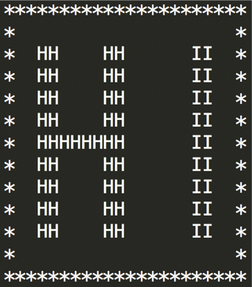
Problem 1
Write a program that prints HI in large block letters inside a border of *. The output should appear as follows:
<number>

Slide 135
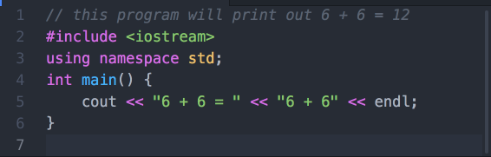
Problem 2
The following program is supposed to print out 6 + 6 = 12
Unfortunately, it doesn’t. Can you fix the problem?
<number>

Slide 136
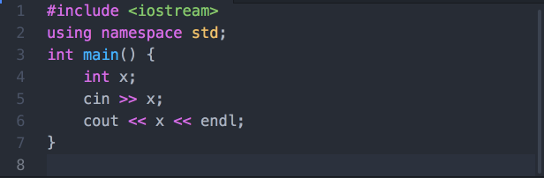
Problem 3
The following C++ program reads in an integer (int) and then output it to screen.
Can you make change to the program so that it reads in two integers, and output both their sum and their product?
<number>

Slide 137
Problem 4
Write a complete C++ program that reads two integers into two int variables a and b, and outputs both the quotient and the remainder when a is divided by b. For example, if a = 10 and b = 3, then the output should be as follows.
<number>

Slide 138
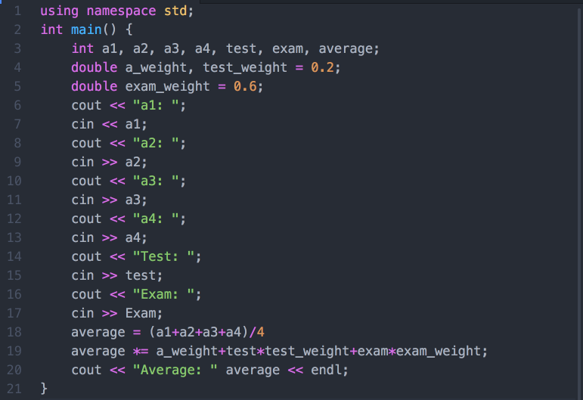
Problem 5
What are the problems in the following program? Can you fix them? (hint: first guess what this program wants to achieve)
<number>

Slide 139
Optional.
For those who would like to challenge yourselves. Even for those of you who are beginners in C++ programming, it’s highly recommended for you to take a look at these problems and try to tackle them as well.
You are welcome to discuss these problems in the Moodle forum.
CHALLENGES
<number>

Slide 140
Challenge 1 Modulo operations & overflow
Consider the following line of code:
int product = 654321*123456;
What is the output? Try it in a program. Does it match your expectations?
=====
This unexpected behaviour is called “arithmetic overflow”, which occurs when the size of number is larger than a certain upper-bound. For int, this is 2³² − 1 ≈ 2 * 10⁹.
To resolve this issue, you can try these approaches:
Use a larger data type, eg: “long long”, “double” etc.
Use modulo operations - Sometimes it is likely that you are just interested in the N least significant figures. For example, to calculate the 9-th least significant figures of the product, you can do:
int product = 1LL*654321*123456%1000000000
Try to figure out what the prefix “1LL” does.
<number>

Slide 141
Challenge 2
You may know that a = a + b can be written as a += b instead, but what if we use “chain” them together?
Some examples:
a += b += c
a *= b *= c
a += b %= c
(a += b) *= c
If the initial values for the variables of a, b and c are a = 4, b = 3, c = 2, then what will be the value of each of the above example expressions after going through each operation? Can you explain the reason behind it?
<number>

Slide 142
Challenge 3
Write a program in C++ to find the average of 5 numbers using 2 variables only.
<number>

Slide 143
Challenge 4
Write a program in C++ to take in a 3-digit number, and output the reverse of the digits.
For example,
if the input is 136, the output should be 631
if the input is 401, the output should be 104
<number>

